Slide 1
Textile Industry
By
Aditya
Manasvi
Somya

Slide 2
Introduction
Most of the commercial rayon manufacturing today utilizes the viscose process.
Manufacturing techniques have shifted from Batch process to semi-continuous.
Major part of the fiber produced today is regenerated cellulose.

Slide 3
Principle Involved
Purified cellulose are chemically converted into a soluble compound (Xanthate along with Caustic Soda) which passes through the spinning machine to form soft filaments that are then converted or “regenerated” into almost pure cellulose.
Because of the reconversion of the soluble compound to cellulose, rayon is referred to as a regenerated cellulose fiber.

Slide 4
About Grasim Industry
Viscose Fibre Plant (using NaOH)
Excel Fibre Plant (using N-Methyl Morpholine Oxide )
CS₂ Plant (5 TPD)
H₂SO₄ Plant (3600 TPD)
Thermal Power Plant (Voltage is 6.6 kV at 50 Hz frequency)

Slide 5
About Grasim Industry
Raw Materials:
Pulp, NaOH, Carbon Disulphide Spin Bath (Sulphuric Acid, Sodium Sulphate & Alum).
Product:
Viscose Fiber

Slide 6
Process Involved
Steeping : Mixing Cellulose with NaOH in Slurry Mixer.
34% pulp, 18% caustic and the rest water in Slurry Press
Alkali Cellulose Production in Aging Drum.
Xanthation in Simplex.
Homogenization of the Solution
Regeneration Process in Spinning Machine
Recovery of Sulphuric acid, CS₂ and Sodium Sulphate.
Drying and Cutting of Fiber.

Slide 7
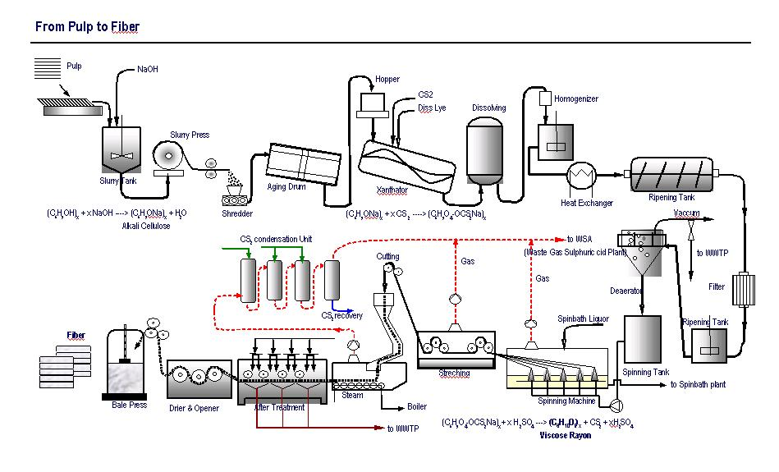

Slide 8
Process and Equipment Description
Equipment: Slurry Mixer & Slurry Press
Process: Mixing of wood pulp and Caustic Soda
Mixture is soaked for around 5 hours until it becomes dark brown in color.
Mixed properly such that the solution contains 34% pulp, caustic 18% and the rest water.
After this the slurry goes to Aging Drum.

Slide 9
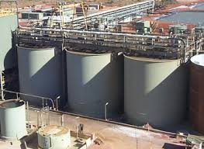
Manufacturer:
Storth Ltd, UK

Slide 10
Process and Equipment Description
Equipment: Aging Drum
Process: Formation of Alkali Cellulose (Alkcel).
(C₆H₉O₄-OH)n + nNaOH → (C₆H₉O₄- ONa)n + nH₂O
(Cellulose) (Alkcel)
This mixture goes into the Xanthator for further processing.

Slide 11
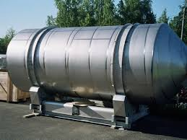
Manufacturer:
Yokogawa, Japan

Slide 12
Process and Equipment Description
Equipment: Simplex / Xanthator
Process: Xanthation
Formation of Xanthate takes place by addition of CS₂ to alkali cellulose (sourced from aging drum).
(C₆H₉O₄-ONa)n + nCS₂ → (C₆H₉O₄- ONaCS₂)n
(xanthate)
This reaction takes place in vacuum.

Slide 13
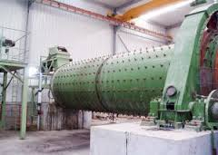
Manufacturer:
HongPeng, China

Slide 14
Process and Equipment Description
Equipment: Spinning Machine
Process: Regeneration of Cellulose
After the Deaerator , solution is pumped through spinnerets of 60-70 microns (spinning machine) in the spin bath (Sulphuric Acid) at 48 deg C.
This coagulates Cellulose Xanthate in to filaments , which are 100% cellulose and hence it is called Regeneration process.
Properties of fiber such as luster, strength and affinity for dyes are altered here.

Slide 15
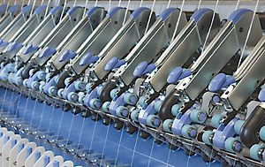
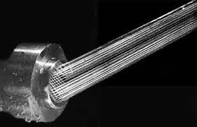
Shanghai Zibang Industrial Co. Ltd., China

Slide 16
Process and Equipment Description
Equipment: Recovery Trough
Process: Recovery of CS₂, Sulphuric Acid and Sodium Sulphate
Steam wash: This is used to remove CS2
First Wash: The fibre is cleaned with 60 degree Celsius water.
Desulph Bath: NaOH (0.06%) at 90 degree Celsius is added to remove sulphuric acid and sodium sulphate.
Desulph Wash: Water at 60 degree Celsius is added to clean the fibre.
Bleach Bath and Bleach Wash: Chlorine (0.2%) and NaOH (0.03%) is added to increase its whiteness. This process occurs at 55 degree Celsius.
Acetic Acid Bath: Acetic Acid (2gpl) is added to maintain the ph of the fibre.
Soft Finish Bath: Soft Finish (2%) is added to increase its OPU (oil pick up) unit. This improves its texture and smoothness.

Slide 17
Edraw and Suggested Modifications

Slide 18
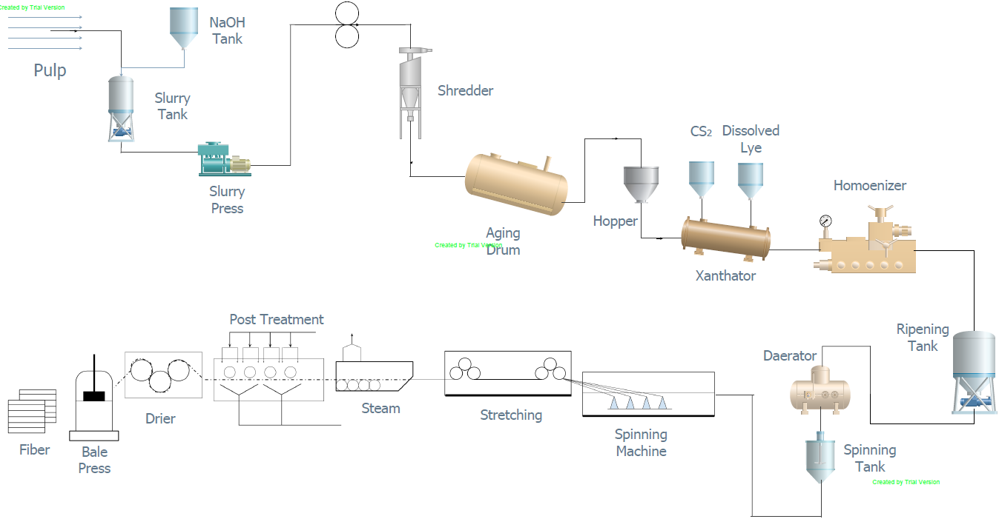

Slide 19
Suggestions
H₂SO₄ Recovery
Issue: Some amount of H₂SO₄ is left on the tow which needs to be removed to reduce the loss of H₂SO₄ and to maintain the quality of the fiber.
Solution: Scrubber can be used at the end in the after treatment section. This will be used specifically for H₂SO4 removal.

Slide 20
Suggestions
Using CO2 in place of H2SO4 will lead to production of Na₂CO₃ instead of Na₂SO₄
Benefits : Saves the installation cost and operating cost of H₂SO₄ plant
Use CO₂ produced in the plant or from the atmosphere (environmental pollution).

Slide 21
Suggestions
Hardide Coating (tungsten carbide based) on inner surface of the equipment.
Avoids pile-up of reactants inside the equipment.
Provides chemical resistance to the metal.
Reduces downtime.
The finish does not degrade over time thus improves the expected life of vulnerable parts

Slide 22
Economy Issues & Pollution Control

Slide 23
Raw Material and Issues
India: 2nd largest cotton producer and abundant supply for wood pulp
Growth in Caustic Soda (NaOH) supply owing to growth in pulp & paper and textile industries
*Global consumption to reach 82MT by 2020
* Global caustic soda market expected to grow at 3% between 2016 and 2020.
*Textile Industry consumption share 13.80%; Need to import Caustic Soda
*Production (2014-15, India): 27.61 Lakh MT; 4% of global market
Carbon DiSulphide (CS₂)
*India: 13% of global consumption, while China (49%)
*Can be accounted for Rayon Fibre industries(viscose rayon) in both countries
*Regenerated Cellulose = 70% of total demand
*Other industries (rubber & agriculture) also compete for consumption

Slide 24
Environmental Concerns
Wastewater generation and atmospheric emissions
High consumption of water, high thermal energy input
Central Pollution Control Board (CPCB)
*Water (Prevention and Control of Pollution) Act, 1974
*Air (Prevention and Control of Pollution) Act, 1981
Solutions
Water Efficiency | Counter Current Washing and Reduction of Carry Over
Material Use Efficiency | Reduce inlet feed, viz. reducing waste stream
Energy Efficiency Improvement | Heat recovery through re-use of cooling water
Process Optimisation | Automated preparation and install automatic controllers
Pollution Control | Conventional: physico-chemical and biological wastewater treatment + Nanofiltration and use of R.O. Fibre recovery system

Slide 25
Future & Growth: SWOT Perspective
Strengths Abundant raw material available Low-cost and skilled manpower Independent & self-reliant industry (India) Varieties of cotton fibre Growing synthetic fibre industry segment | Weaknesses Lack of technological development Infrastructural bottlenecks & efficiency (e.g. at ports) Indian textile industry is fragmented and scattered Highly dependent on cotton
Opportunities Growth rate of domestic industry: 6-8 % per annum Large potential domestic & international mkts Shift towards branded readymade garment India: 2nd largest cotton consumer Market Size (India): Growing middle class with increased disposable income Investment & FDI opportunities | Threats Competition from other developing countries (e.g. China) Expensive eco-friendly technology solutions Threat for traditional handloom products To make balance between price & quality Balance the demand and supply

Slide 26
Remarks
Growth of the Industry & its future
Textile Industry contribution: Exports & Market share
Indian demand for Textile Industry products rising
The industry as an employer
Too big to fail
Environment friendly solutions costly
Govt. needs to step in until better, more efficient and cheaper technology solutions are viable

